Slide 1
The European Commission latest initiatives in the field of public procurement
23 April 2024 – Zagreb, Croatia
Salvatore D’ACUNTO
Head of Unit GROW.E2
Enforcement – Goods, Services to Consumers, Public Procurement, Late Payments
DG GROW
European Commission

Slide 2






Public procurement in the EU
250.000 Public buyers
Numbers
Sectors
EUR
2 Trillion or 14% of GDP
Infrastructure
20% Above thresholds (TED)
Education
Social protection
Energy
Health
80% Below
Thresholds (MS)
Waste

Slide 3
Public procurement – priorities and new perspective
1. Ensuring a legal framework aligned with the strategic objectives: from « how » to « how and what » to procure.
2. Fostering strategic procurement through joint actions and dialogues.
3. Ensuring a playing field by tackling distortive subsidies.
4. Enforcement at European and national level.
5. Looking to the future – follow up to the report of the European Court of Auditors.

Slide 4
1 (A) General legal framework
Directive 2014/24/EU on public procurement.
Directive 2014/25/EU on procurement by entities operating in the water, energy, transport and postal services sectors.
Directive 2014/23/EU on the award of concession contracts.

Slide 5
1 (B) Sectoral legal framework
1. Interplay of this new set of rules with horizontal public procurement law and among them.
2. Coherent implementation of the new provisions.
3. Bigger need for professionalization and administrative capacity of public buyers.
4. Manage the risks of fragmentation.
5. Assess the impact on competition.

Slide 6
Regulations
REGULATION | DESCRIPTION OF PP PROVISIONS | STATE OF PLAY
Chips Act (ECA). Regulation (EU) 2023/1781 of the European Parliament and of the Council of 13 September 2023 establishing a framework of measures for strengthening Europe’s semiconductor ecosystem and amending Regulation (EU) 2021/694 | Common purchasing: If risk of serious disruption in the supply of semiconductors the Commission could act as a central purchasing body. An extraordinary meeting to discuss joint purchasing as a preventive measure could be arranged | Enter into force 21 Sept 2023.
Batteries. Regulation (EU) 2023/1542 of the European Parliament and of the Council of 12 July 2023 concerning batteries and waste batteries, amending Directive 2008/98/EC and Regulation (EU) 2019/1020 and repealing Directive 2006/66/EC | Technical specification and award criteria: Requires public buyers when procuring batteries or products containing batteries to consider their environmental impact to ensure that such impacts are kept to a minimum. To this effect, they shall include technical specifications and award criteria based on the criteria enshrined in the Regulation | Enter into force 17 August 2023. Apply from 18 February 2024
Ammunition production (ASAP). Regulation (EU) 2023/1525 of the European Parliament and of the Council of 20 July 2023 on supporting ammunition production | Facilitate joint procurements and award criteria: Sets award criteria measuring the contribution of the proposals to the reinforcement of EU industrial production capacities for ammunition and missiles, like the increase in production capacity in the Union or the reduction of the delivery lead time | Enter into force 25 July 2023
Deforestation. Regulation (EU) 2023/1115 of the European Parliament and of the Council of 31 May 2023 on the making available on the Union market and the export from the Union of certain commodities and products associated with deforestation and forest degradation and repealing Regulation (EU) No 995/2010 | Exclusion ground: MS must lay down penalties, applicable to infringements of the Deforestation regulation that shall include a temporary exclusion (max 12 months) from public procurement processes and access to public funding | Entered into force 29 June 2023. Apply to products produced after 31 December 2020
Foreign Subsidies (FSR). Regulation (EU) 2022/2560 of the European Parliament and of the Council of 14 December 2022 on foreign subsidies distorting the internal market | In-depth review and suspension of awards: Specifies the notification obligation and forms for public procurement procedures involving foreign subsidies; Commission can open in-dept reviews and adopt decisions prohibiting awards | Enter into force 12 Jan 2023. Apply from 12 July 2023

Slide 7
Regulations
REGULATION | DESCRIPTION OF PP PROVISIONS | STATE OF PLAY
Cross-boarder threats to health. Regulation (EU) 2022/2371 of the European Parliament and of the Council of 23 November 2022 on serious cross-border threats to health and repealing Decision No 1082/2013/EU | Joint procurement of medical countermeasures: Commission and any of the MS may engage in a joint procurement with a view to the advance purchase of medical countermeasures | Enter into force 26 Dec 2022
Medical Countermeasures. Council Regulation (EU) 2022/2372 of 24 October 2022 on a framework of measures for ensuring the supply of crisis-relevant medical countermeasures in the event of a public health emergency at Union level | Framework of measures concerning procurement: Procurement, purchase and manufacturing of crisis-relevant medical | Adopted on 24 Oct 2022
International Procurement Instrument (IPI). Regulation (EU) 2022/1031 of the European Parliament and of the Council of 23 June 2022 on the access of third-country economic operators, goods and services to the Union’s public procurement and concession markets and procedures supporting negotiations on access of Union economic operators, goods and services to the public procurement and concession markets of third countries | Trade policy tool: Promotes a level playing field in access to public procurement and concession markets in third countries. Allows EU to limit or exclude access to its public procurement markets by economic operators, goods or services from third countries that do not offer similar access to EU companies | Enter into force 29 Aug 2022
Russian Sanctions. Council Regulation (EU) No 833/2014 of 31 July 2014 concerning restrictive measures in view of Russia's actions destabilising the situation in Ukraine | Exclusion ground: Exclusion of Russian contractors, subcontractors and persons in control | Enter into force 9 April 2022
Exercise of Union’s rights under ITAs. Regulation (EU) No 654/2014 of the European Parliament and of the Council of 15 May 2014 concerning the exercise of the Union's rights for the application and enforcement of international trade rules and amending Council Regulation (EC) No 3286/94 laying down Community procedures in the field of the common commercial policy in order to ensure the exercise of the Community's rights under international trade rules, in particular those established under the auspices of the World Trade Organization | Exclusion ground and mandatory price penalty: Exclusion of economic operators as international retortion | Enter into force 25 Nov 2015

Slide 8
Directives
DIRECTIVES | DESCRIPTION OF PP PROVISIONS | STATE OF PLAY
Revision of the Energy Efficiency Directive (EED). Directive (EU) 2023/1791 of the European Parliament and of the Council of 13 September 2023 on energy efficiency and amending Regulation (EU) 2023/955 | Conditions for purchasing: MS shall ensure purchase of products, services, buildings and works with high energy efficiency, and must apply the “principle of energy efficiency first” over thresholds | Adopted Sept 2023. Transposed by 30 June 2024
Equal Pay for Equal Work. Directive (EU) 2023/970 of the European Parliament and of the Council of 10 May 2023 to strengthen the application of the principle of equal pay for equal work or work of equal value between men and women through pay transparency and enforcement mechanisms | Equal pay in public contracts and concessions: MS shall ensure that in the performance of public contracts economic operators comply with the obligations relating to equal pay | Adopted May 2023. Transposed by 7 June 2026
Minimum wages. Directive (EU) 2022/2041 of the European Parliament and of the Council of 19 October 2022 on adequate minimum wages in the European Union | Measures to ensure awarding and performance in the field of social and labour law: MS shall ensure that economic operators and their subcontractors comply with applicable obligations regarding social and labour law | Adopted Oct 2022. Transposed by 15 Nov 2024
Women on Boards. Directive (EU) 2022/2381 of the European Parliament and of the Council of 23 November 2022 on improving the gender balance among directors of listed companies and related measures | Compliance with obligations relating to social and labour law: MS shall ensure that listed companies comply with applicable obligations in the performance of public contracts and concessions | Adopted Nov 2020. Transposed by 28 Dec 2024

Slide 9
Directives
DIRECTIVES | DESCRIPTION OF PP PROVISIONS | STATE OF PLAY
Clean Vehicles Directive (CVD). Directive (EU) 2019/1161 of the European Parliament and of the Council of 20 June 2019 amending Directive 2009/33/EC on the promotion of clean and energy-efficient road transport vehicles | Minimum procurement targets: MS shall ensure that procurement of vehicles complies with the minimum procurement targets for clean light-duty vehicles | Adopted June 2019. Transposed by 2 August 2021. Amended 2023
Accessibility. Directive (EU) 2019/882 of the European Parliament and of the Council of 17 April 2019 on the accessibility requirements for products and services | Mandatory accessibility requirements: the directive establish mandatory accessibility requirements for products and services covered by it | Adopted April 2019. Transposed by 28 June 2022. Measures shall apply from 28 June 2025
eInvoicing. Directive 2014/55/EU of the European Parliament and of the Council of 16 April 2014 on electronic invoicing in public procurement | Obligatory acceptance of eInvoice: Promotes the uptake of electronic invoicing in public procurement | Adopted April 2014. Transposed by 27 Nov 2018

Slide 10



2 (A) Strategic procurement - overview
Innovation procurement
Green public procurement
Socially responsible public procurement
Initiatives to promote the procurement of innovative solutions
Reducing the environmental impact of public procurement
Using public contracts to achieve positive social outcomes
Guidance on innovation procurement
Big buyers Initiative: collaboration in strategic PP for innovative goods and services
10 working groups with focus on ICT, green, health & social procurement
Dialogue with MS on the use of strategic procurement (so far 13 workshops)

Slide 11
3 Ensuring a level playing field – Foreign Subsidies Regulation
Objective: Ensure level playing field.
EU control of State aid granted by Member States, but no control of foreign subsidies;
Instances of foreign subsidies impacting the Internal Market? Subsidised concentrations (mergers and acquisitions);
Subsidised tenders in public procurement.
Regulatory gap: none of the already existing tools can adequately tackle distortions caused by foreign subsidies on the internal market.

Slide 12
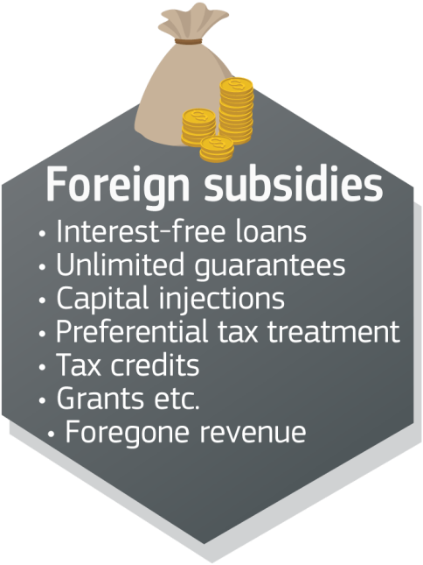
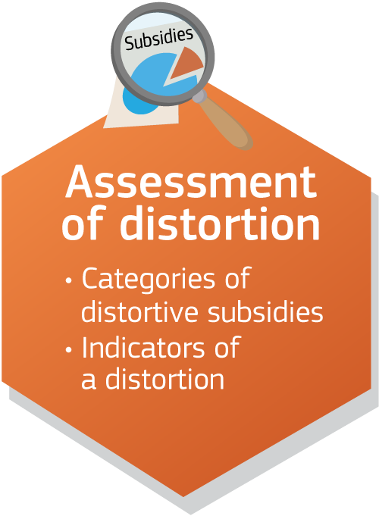
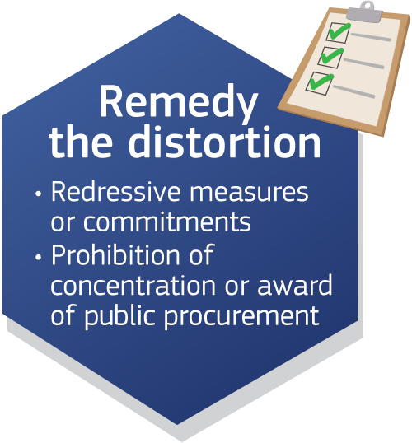


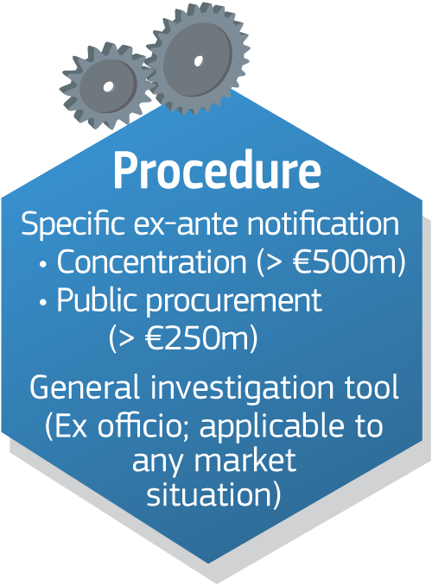
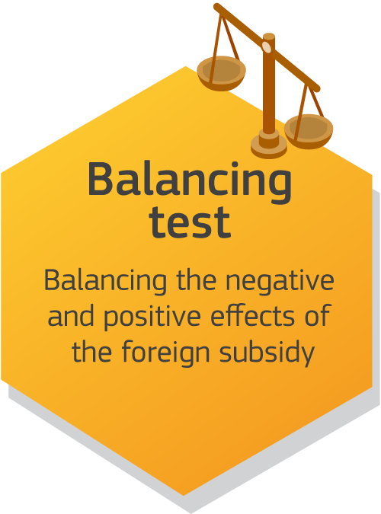
Regulation (EU) 2022/2560 (FSR) at a glance

Slide 13
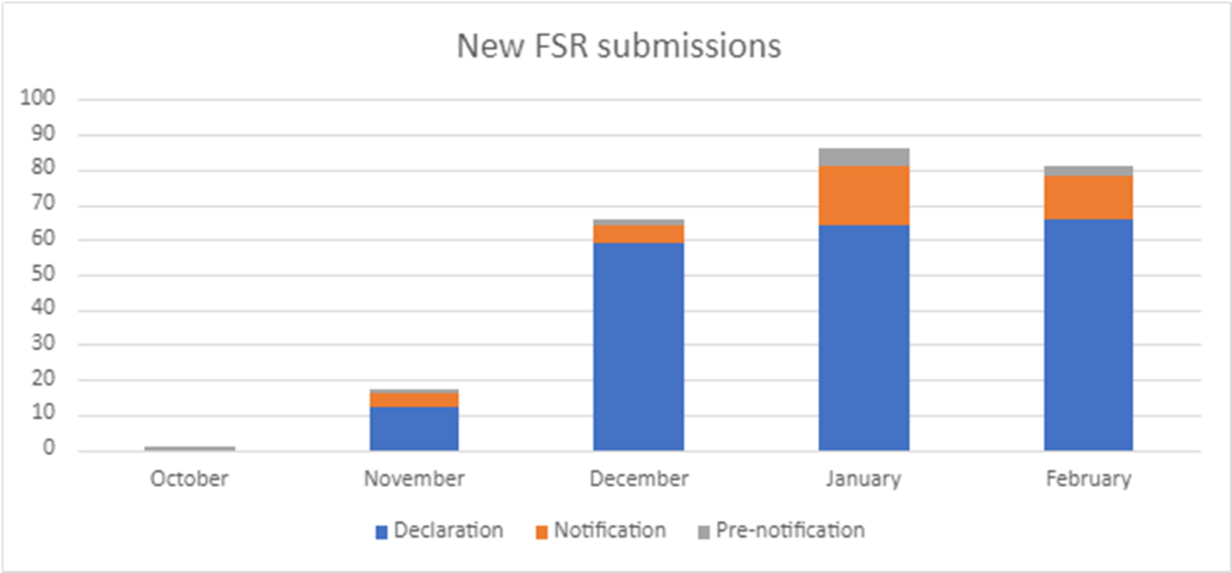
FSR – State of play (as of 11 March 2024)
In total 272 submissions received for 67 different tender procedures since the start of the notification obligation of the FSR on 12 October 2023, in the following breakdown:
- 39 notifications
- 221 declaration

Slide 14
4 Enforcement at European and national level
European Commission
Infringements
Member States
Network of First Instance Review Bodies on Public Procurement

Slide 15
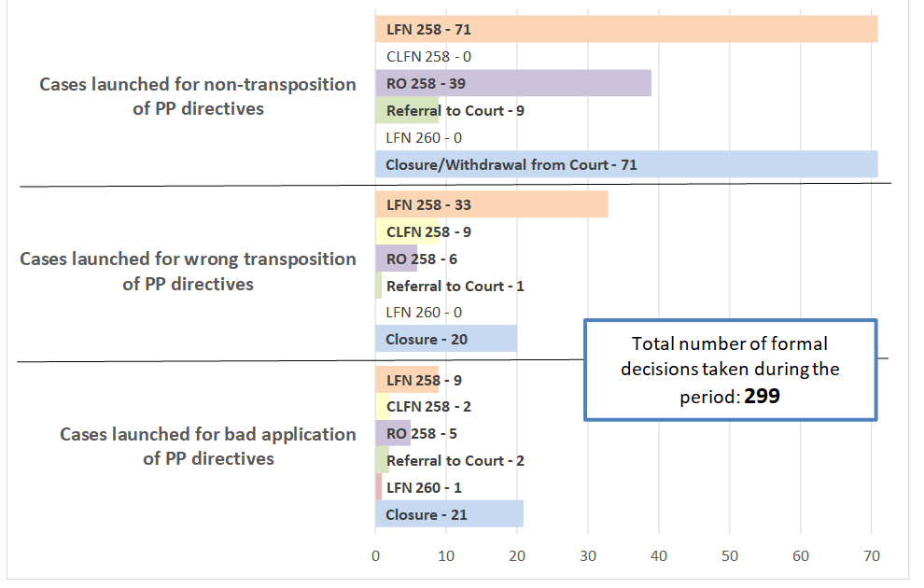
Enforcement in the public procurement
25/05/2016 – 15/03/2024
Requests for preliminary ruling: 79

Slide 16
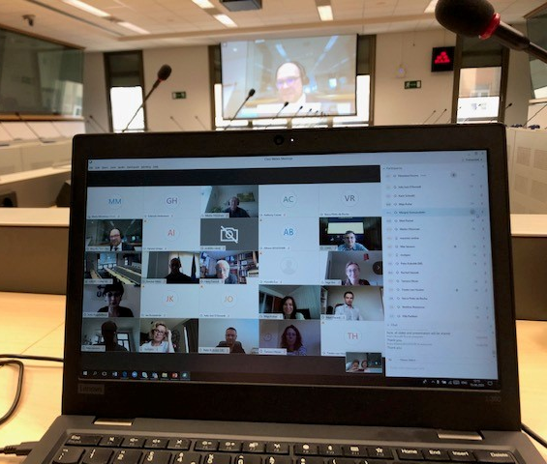
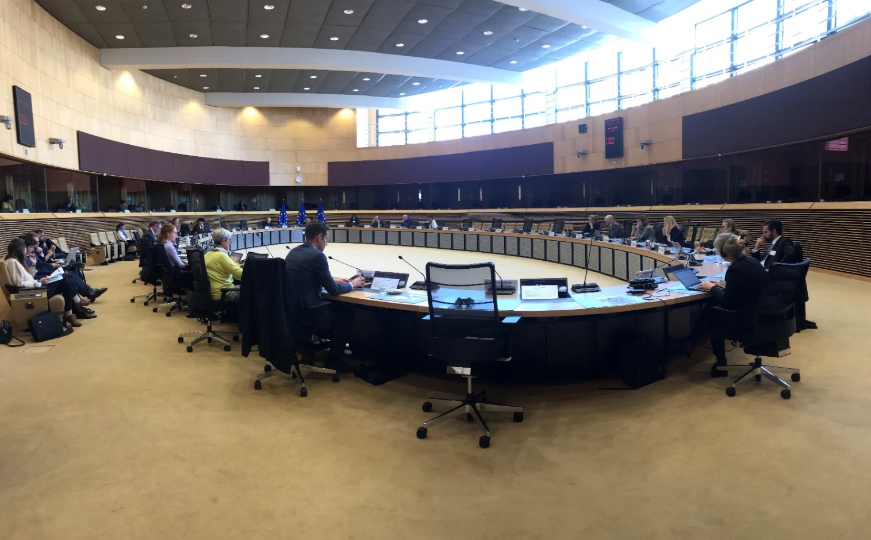
Network of First Instance Review Bodies
Meeting in June 2020 Meeting in May 2022

Slide 17

Public procurement review bodies
Based on principle of national procedural and institutional autonomy, Member States are free to decide which body is responsible for the review procedure, provided all following requirement of Remedies Directives are fulfilled:
  Independent body from contracting authority/entity;
  May be different for different aspect of the review;
  Judicial or not judicial in character;
  When not judicial (Art. 2(9) Remedies Directive):
    Written reasons of decisions;
    Review by either a judicial body or by another body that is independent and has the power to request preliminary rulings from CJEU.

Slide 18
First instance public procurement review bodies in EU Member States
Member States have established review bodies varying in nature:
  Specialised or general;
  Judicial or administrative.
Specialised bodies | Non-specialized bodies
Judicial: PT | Judicial: AT, BE, FR, IE, LT, LU, NL, IT, FI, SE
Administrative: BG, CY, CZ, DE, DK, EL, ES, HR, HU, EE, LV, MT, PL, RO, SI, SK

Slide 19




The Network of First Instance Review Bodies
Since March 2017, delegates from EU countries (plus Norway and Switzerland) meet twice a year to discuss follow-up actions to the 2017 evaluation, such as:
  Facilitating exchanges of information and good practice;
  Helping identifying needs and solutions;
  Boosting networking and cooperation;
  Monitoring the progress of setting up review indicators to support the efficient functioning of first instance review bodies.

Slide 20
5 Looking to the future
Follow up to the report of the European Court of Auditors
The Commission welcomes the special report and agrees with its recommendations. Timely report.
The right balance between fair competition and the objectives of resilience and sustainability needs to be found.
Commission will respond to the request to identify the root causes of limited competition and consider whether specific actions, if needed of a legislative nature, may be required.
Process to be defined. But cooperation of Member States, experts and stakeholders is essential.

Slide 21
Thank you

